Slide 1
ICA5NT 584 CUSTOMER CHURN ANALYSIS USING MFNN 21.03.2024
Rishikesh. C, Vishnu. N, Vishva. K, Dr. G. Uma Maheshwari, Dr. A. Meenakshi
Department of Computer Science and Engineering, Kamaraj College of Engineering and Technology, Anna University, Virudhunagar, Tamil Nadu, India

Slide 2
INTRODUCTION
Customer churning is the process of analyzing the customers behaviors where they withdraw their accounts so that the banks can identify clients who are expected to exit and put retention measures in place by receiving information about attrition patterns.
This strategy increases the long-term relationships with client and bank. High attrition rates might be a sign of deeper problem.
For banks to overcome these obstacles and improve their entire customer experience, it is imperative that they comprehend and manage client attrition

Slide 3
PROBLEM STATEMENT
In the competitive world of banking, maintaining the customer is crucial. Banks need to tackle all the challenges to retain their customers in a rapidly changing market. To make the bank profitable, it's vital to understand why customers leave (churn) and find ways to keep the customer.
By using previous data to predict exited customers and find insights to keep customers integrated with the bank. This research initially analyses ten thousand customers data by various features and techniques. The goal is to analyze how the proposed model will predict the exited customers optimally.

Slide 4
OBJECTIVE
To preprocessed the given dataset by cleaning and transforming respective attributes
To develop a MFNN predictive model that can anticipate percentage of customers are at risk of leaving the bank optimally.
To identify patterns and indicators that lead to customer churn.
To analyse the proposed model fitted with optimal accuracy with the given data.

Slide 5
SOFTWARE AND HARDWARE REQUIREMENTS
Software Requirements
Tensorflow
Scikit learn
Keras
Matplotlib
Hardware Requirements
Processor :i3- 12th gen
RAM :8 GB
Storage :512 GB

Slide 6
DATA PRE-PROCESSING
The goal is to prepare a clean, accurate, and reliable dataset for further analysis or modeling.
In this paper, there are 10,000 customer cases with zero null cells and the dataset needs to eliminate the uncorrelated fields for fitting in the model i.e., Surname, Customer ID, and Row number.
Using the ‘isnull()’ method in Pandas, the null data could be estimated. In this dataset there is no null data

Slide 7
VARIABLE CONVERSION
In this dataset the fields namely Geographical location and gender stated in categorical data, which need to be transformed into numeric data without manipulating the data.
Applying the ‘pd.get_dummies’ function to this Data Frame, specifying the categorical column (e.g., 'gender'), it transforms each category into a new binary (0 or 1) column. For each unique category, a new binary column is created. Simillar function for three categories (Germany, Spain, France)
The resulting Data Frame contains the original numerical columns along with the new binary columns representing the categories. This transformed dataset is suitable for machine learning algorithms that require numerical input.

Slide 8
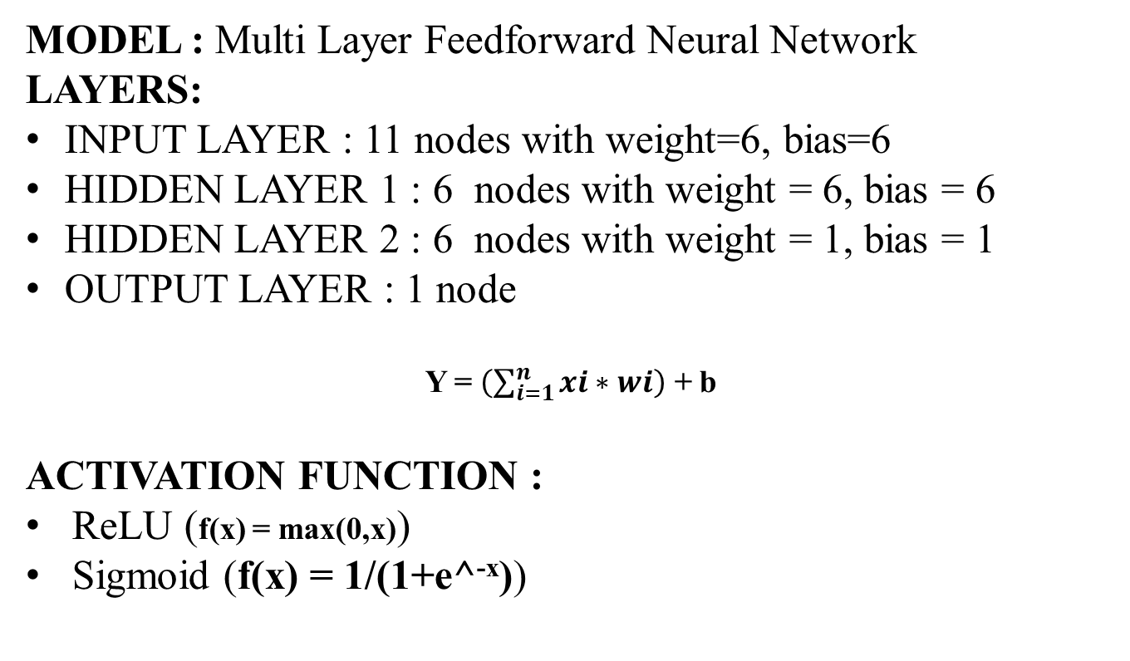
MODEL BUILDING
MODEL : Multi Layer Feedforward Neural Network
LAYERS:
INPUT LAYER : 11 nodes with weight=6, bias=6
HIDDEN LAYER 1 : 6 nodes with weight = 6, bias = 6
HIDDEN LAYER 2 : 6 nodes with weight = 1, bias = 1
OUTPUT LAYER : 1 node
Y = $\left(\sum_{i=1}^{n}{xi∗wi}\right)$ + b
ACTIVATION FUNCTION :
ReLU (f(x) = max(0,x))
Sigmoid (f(x) = 1/(1+e^^{-x}))

Slide 9
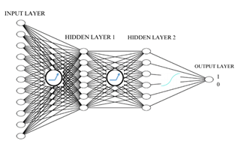
MFNN MODEL

Slide 10
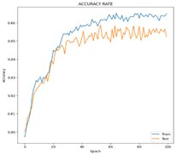
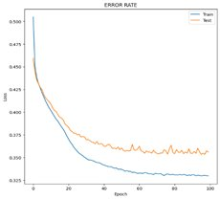


OUTPUT
ACCURACY
ERROR
ACCURACY= $\frac{1518+203}{1518+203+77+202}$=$\frac{1721}{2000}$
ACCURACY= 86.05%
ERROR= $\frac{77+202}{1518+203+77+202}$ =$\frac{279}{2000}$
ERROR = 13.95%

Slide 11
RESULTS
 | PREVIOUS WORK |  | PROPOSED WORK
MODEL | RANDOM_FOREST | XG BOOST | MFNN
ACUURACY RATE | 0.8440 | 0.8520 | 0.8605
ERROR RATE | 0.1660 | 0.1480 | 0.1395
The results of the respective algorithms (i.e., random forest, XG Boost algorithms) of the previous work kin this dataset by Pahul Preet Singh ., Fahim Islam Anik ., et al 2024 [4].

Slide 12
CONCLUSION
This research concludes by predicting the Customers behavior exiting the bank. Among them with their financial behavioral pattern with 86% accuracy from the Multi Layered Feedforward Neural Network Model (MFNN), there is a scope for improving the accuracy in terms of back propagation of the neural network model by association complex algorithms, especially Feedback Recurrent Neural Networks, leading to more impactful predictions

Slide 13
REFERENCE
Machado, M.R., Karray, S., et al 2022. Applying hybrid machine learning algorithms to assess customer risk-adjusted revenue in the financial industry. Electron. Commer. Res. Appl. 56 (Nov.), 101202.
Aishwarya Saxena., Anushi singh., et al 2023. Analyzing customer churn in banking: A data mining framework.
Aurélie Lemmens., et al. 2023. Managing Churn to Maximize Profit.
Pahul Preet Singh., Fahim Islam Anik., et al 2024. Investigating customer churn in banking: A machine learning approach and visualization app for data science and management.

Slide 14
THANK YOU

